Slide 1
Buoy Project
Buoy Project
Robert Wieland, Mike Divitto, Talita Atahalpa, Kevin Anderson, Bryan Darcy
Robert Wieland, Mike Divitto, Talita Atahalpa, Kevin Anderson, Bryan Darcy

Slide 2
Group Members
Robert Wieland
Kevin Anderson
Mike Divitto
Talita Atahalpa
Bryan Darcy

Slide 3
Goals of the project
Monitor temperature at different depths in a lake at regular intervals
Collect and store the data locally if no network connection is available
Fetch the data, then upload to a central repository
Develop a web interface
Be able to add other sensors

Slide 4
Components of the project
Hardware
Pi, 5 temperature sensors, Cable 5 wires 18 awg, Solar Panels, Batteries
Breadboard, wiring, etc. Stepper Motor
Software:
Read the sensors temperature and store at database
Sync the data to a local repository
Display the data at a website
Floating System
Board, Water bottles, Container w/ Components

Slide 5
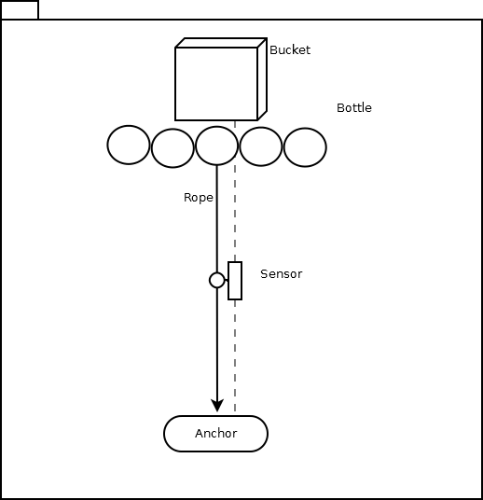
First Implementation
Bucket w/ Components
Pi, Motor, Batteries
Bottles
To keep afloat
Rope w/ Anchor
Guide the sensor up and down
Sensor
Temperature Readings

Slide 6
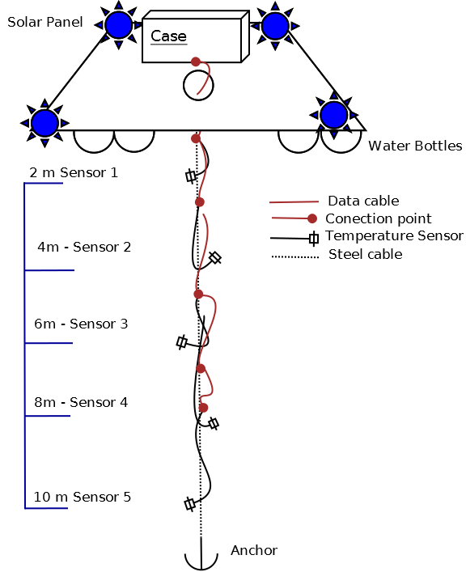
Second Implementation
Floating system
Board, Water Bottles
Bucket with components:
Steel Cable with Anchor
5 Temperature Sensors

Slide 7
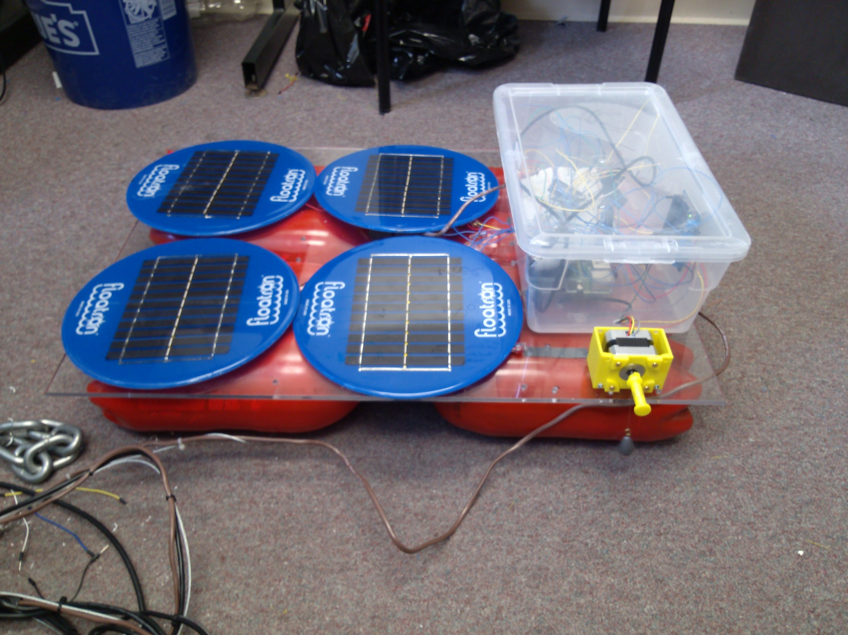
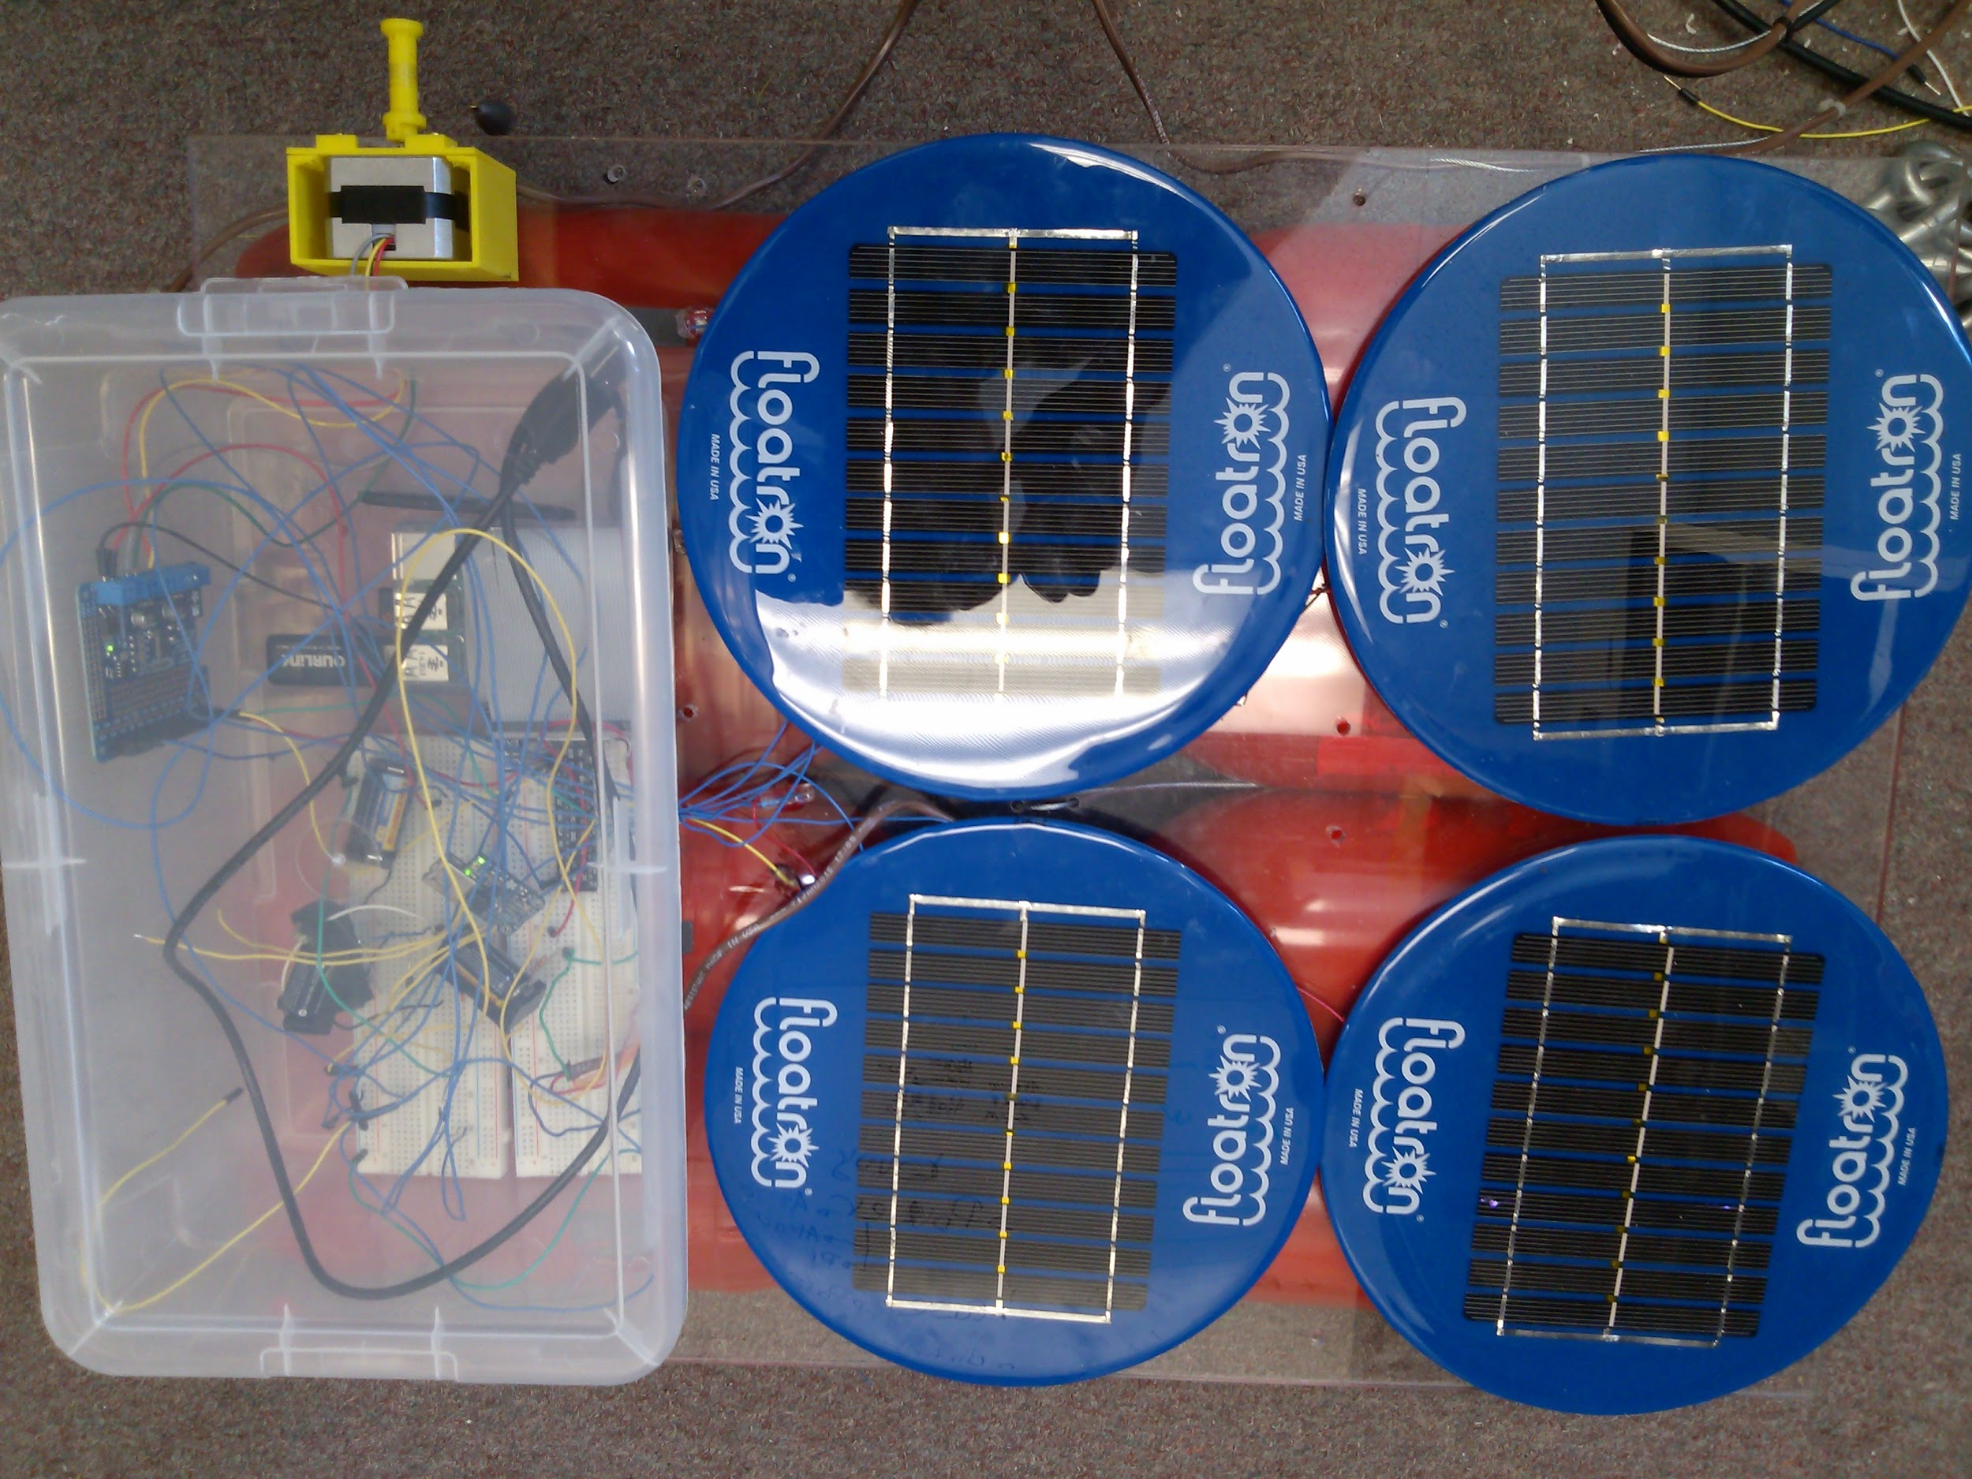

Slide 8
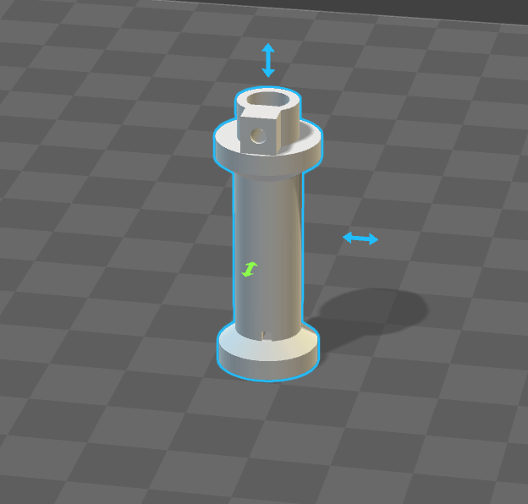
3D Model for Spool
We had to print a spool to add to the motor.
The model is from thingiverse by kirberich.

Slide 9
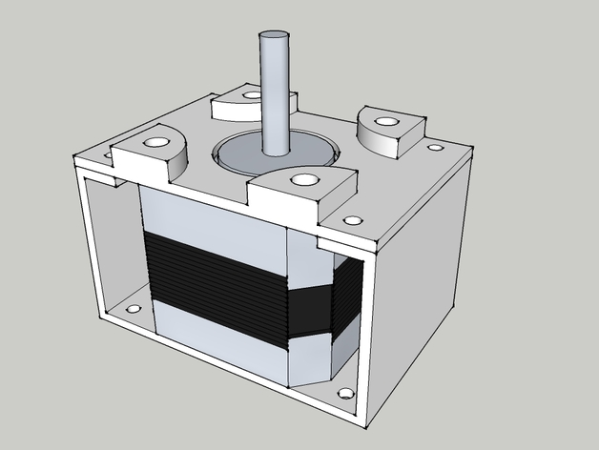
3D Housing for the Motor
Casing for the Motor
Helps mount the motor to the buoy

Slide 10
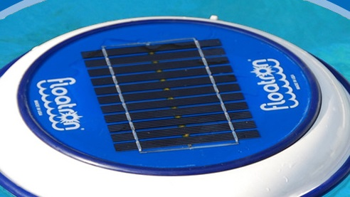
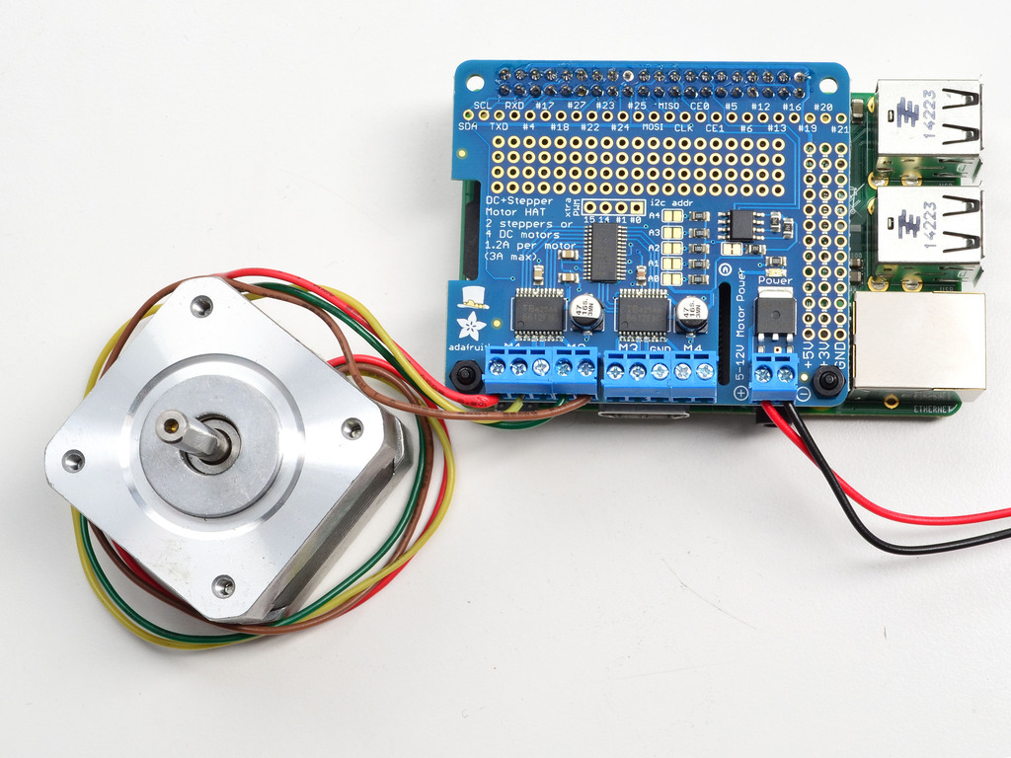
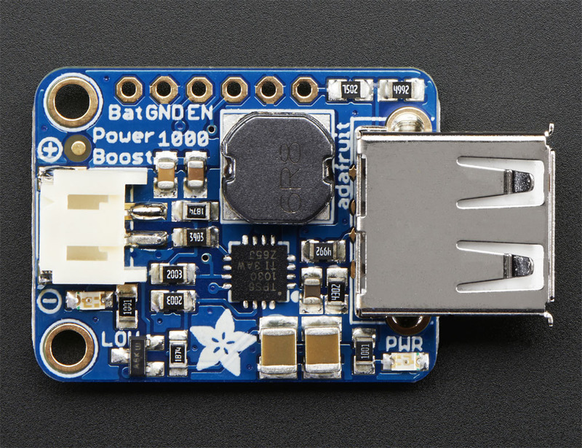
Solar Power Components

Slide 11
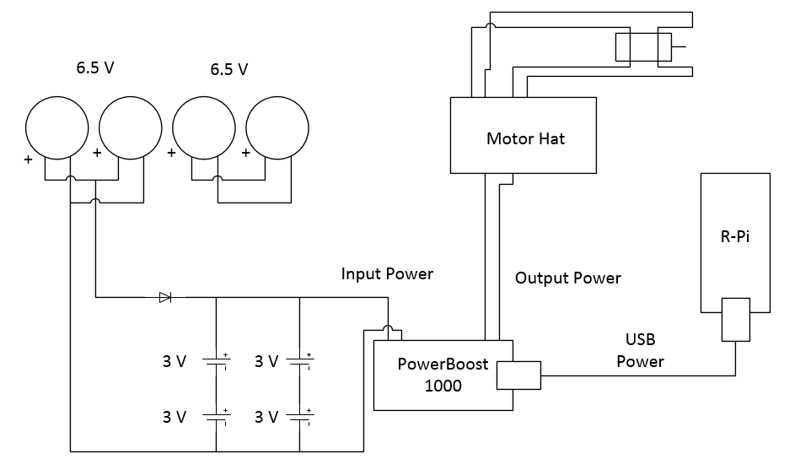
Wiring Diagrams
Initial Design

Slide 12
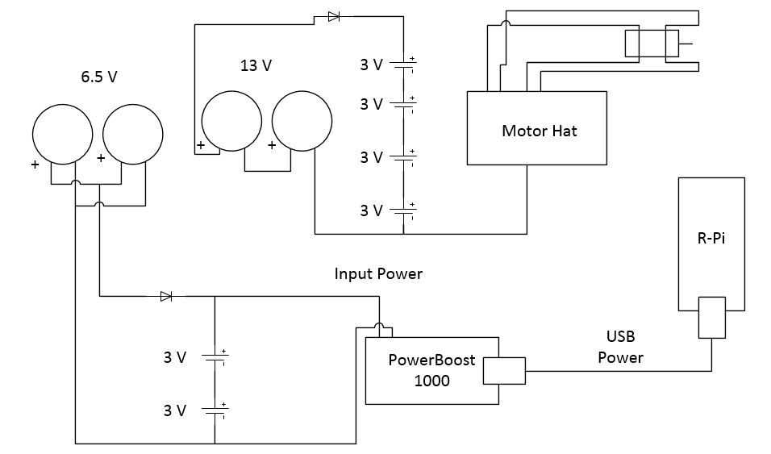
Wiring Diagrams
Motor Isolated Design

Slide 13
Software Implementation
Python script:
Take all five temp readings
Log temp readings into SQLite3 with date and time
Cron:
Will will run the script every 15 minutes.

Slide 14
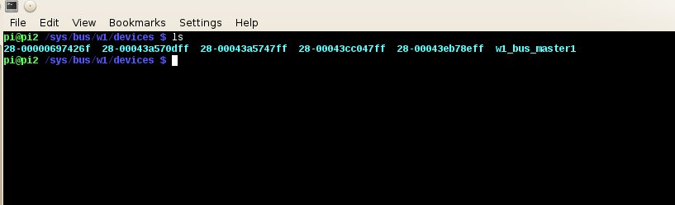
Serial Numbers for 5 temp sensors

Slide 15
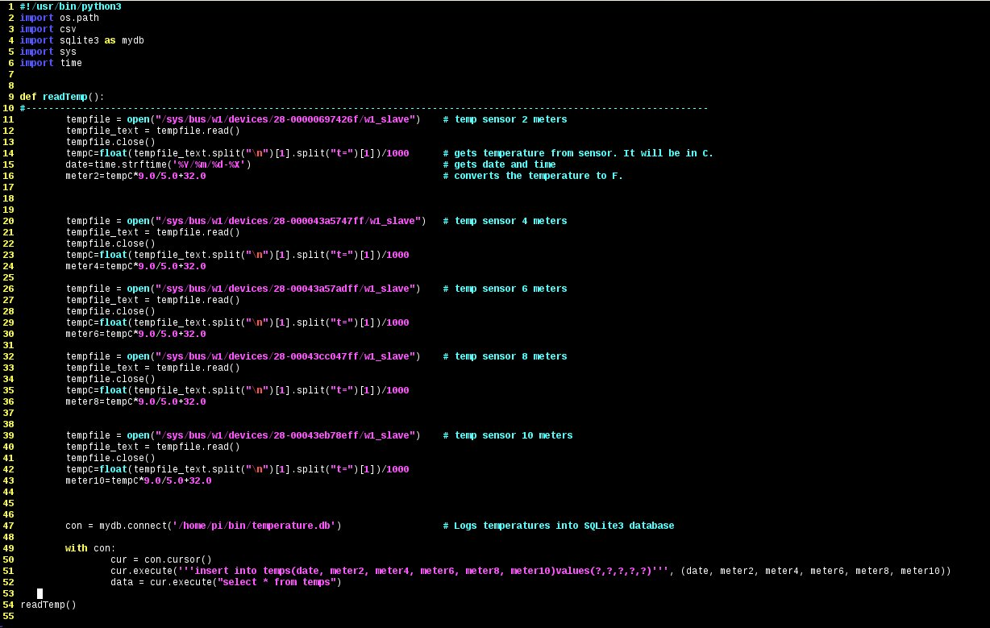
Temperature Reading/Data Log Code

Slide 16
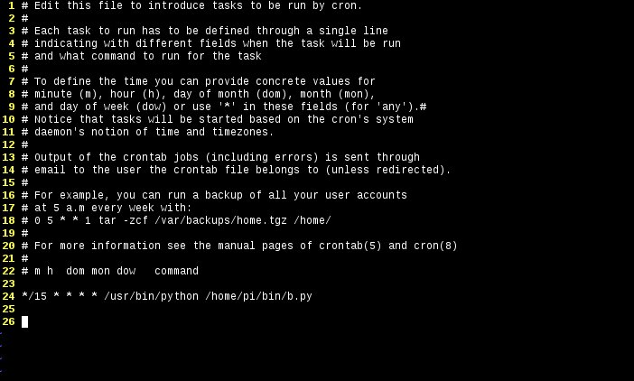
Running Python Code W/ cron

Slide 17
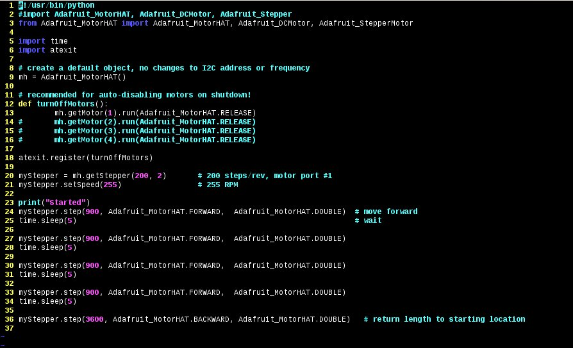
Motor Code python

Slide 18
Data Management
Storing the Data
Saves each reading to a local SQLite3 database
Transferring the Data
SCP into the Pi and fetch the database file
Upload the database file to the server

Slide 19
Web Component
Web Interface
Graph data at each level
Google Map w/ Location of Buoy
Team Member information

Slide 20
Possible Expansions
Add additional sensors
pH Sensor
GPS
Wirelessly Push the data directly to the server

Slide 21


